Slide 1
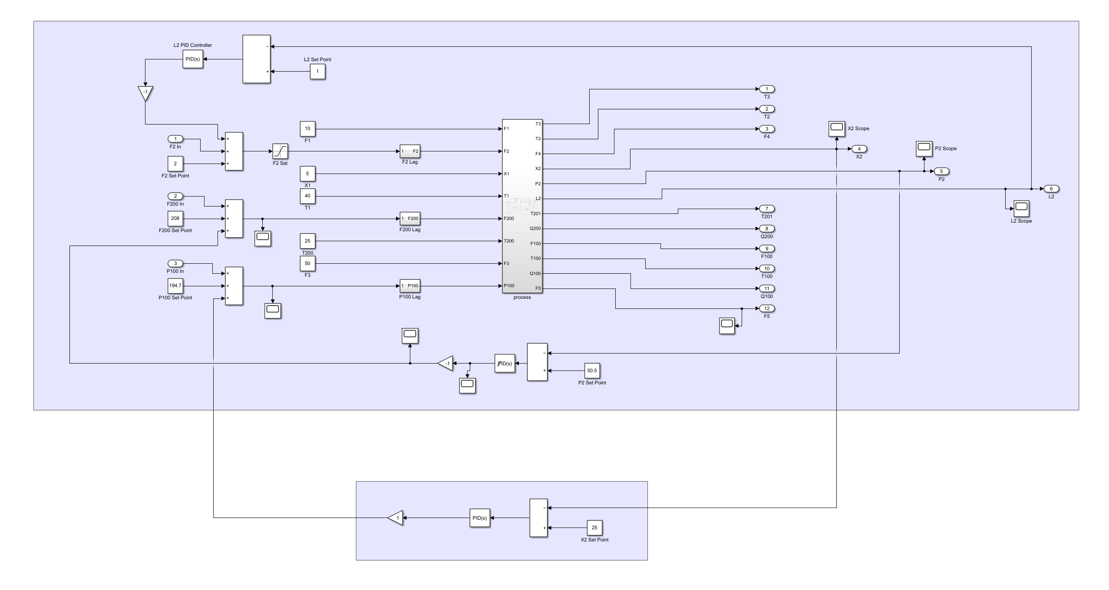
P100
X2

Slide 2
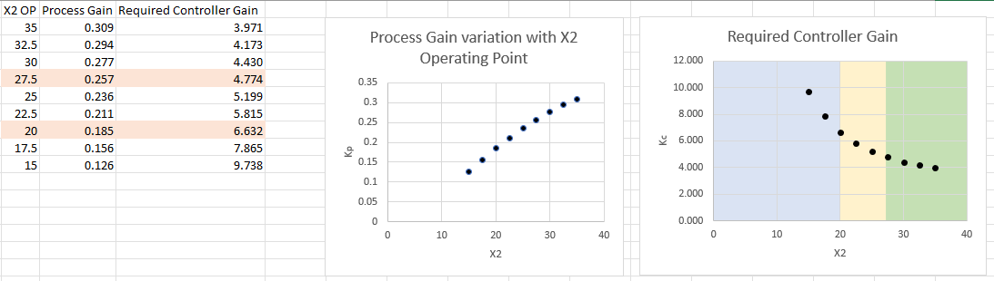


$$K_{P}K_{c}=K_{overall}$$
(Process non-linearity was very similar between pairs)
Method:
Set X2 to desired value in PI controlled system
Measure steady state P100
Break P100-X2 control loop
Set P100 at required value for each X2 of interest
Small step in P100
Measure step in X2
vii. Process gain $K_{p}=\frac{ΔX2}{ΔP100}$

Slide 3
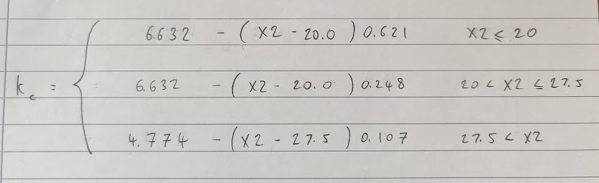
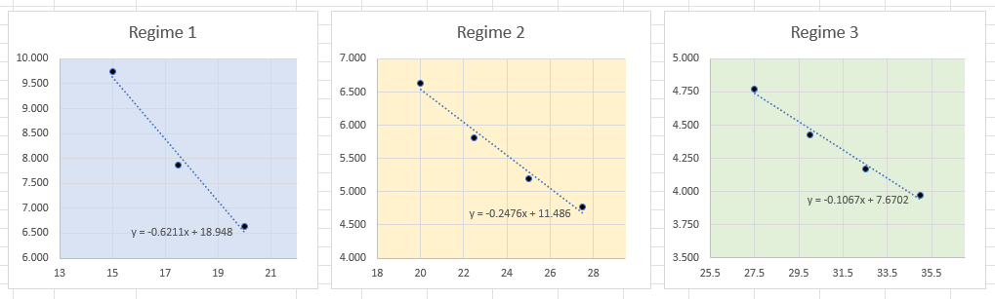

Slide 4
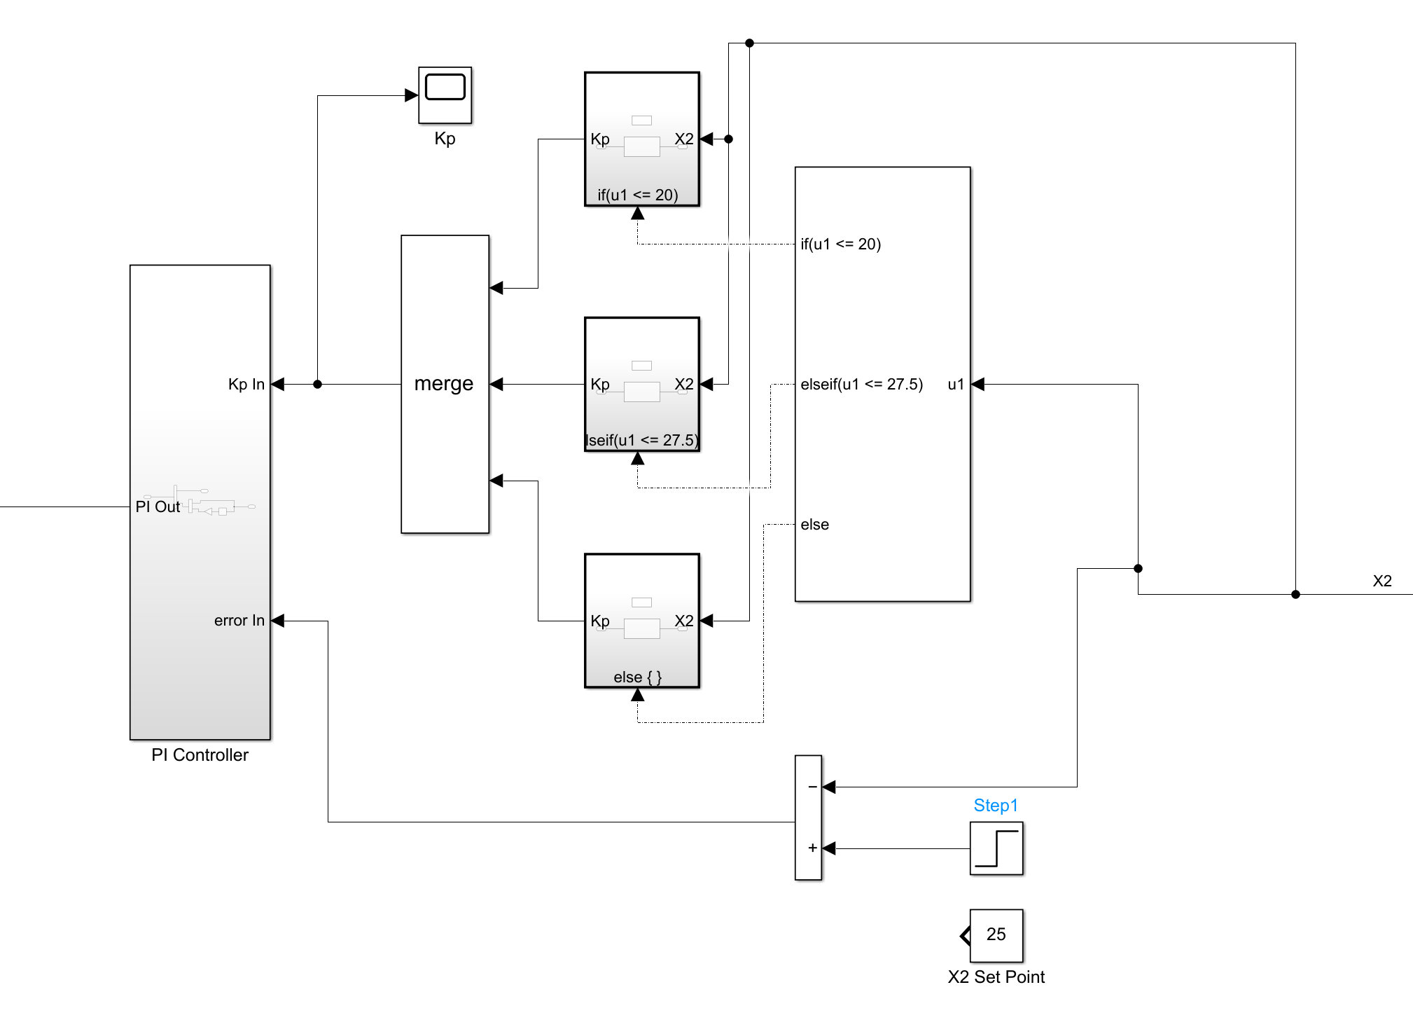
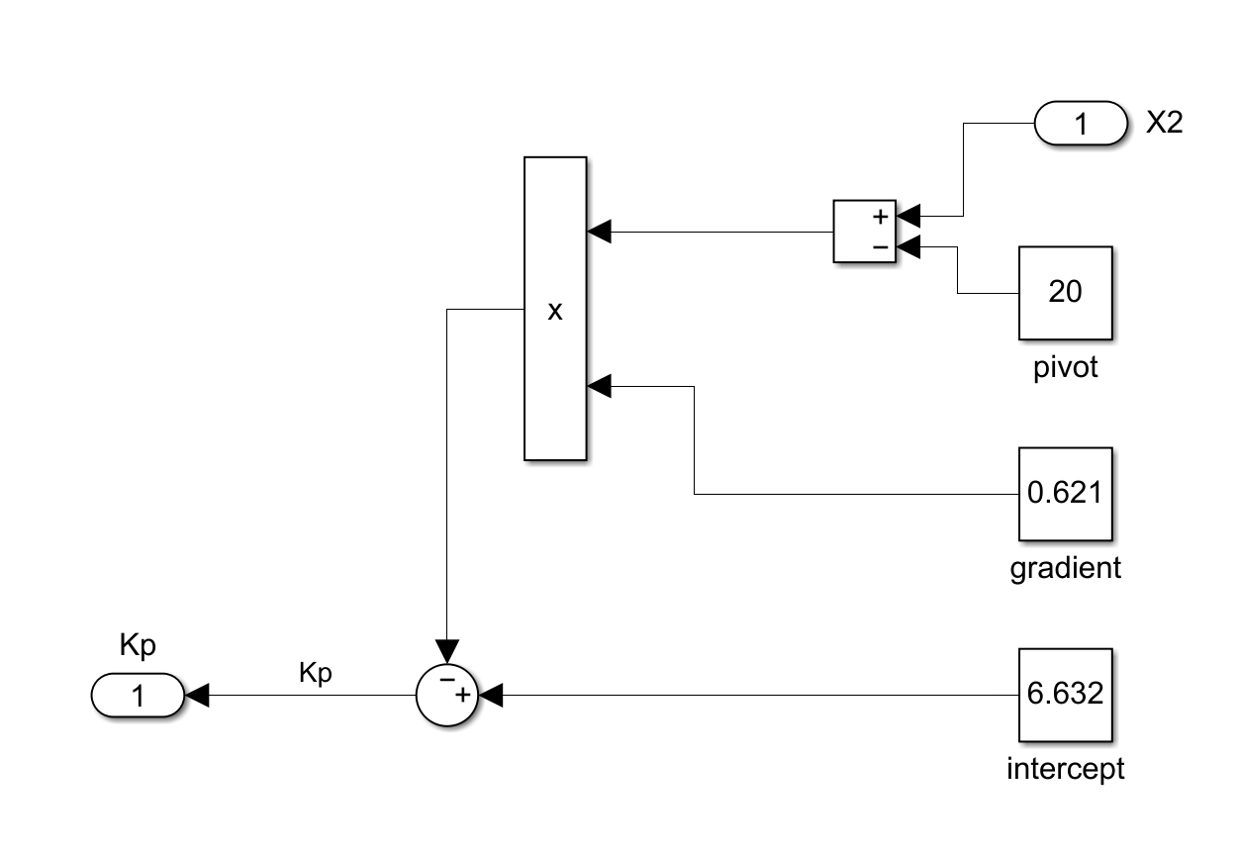

Slide 5
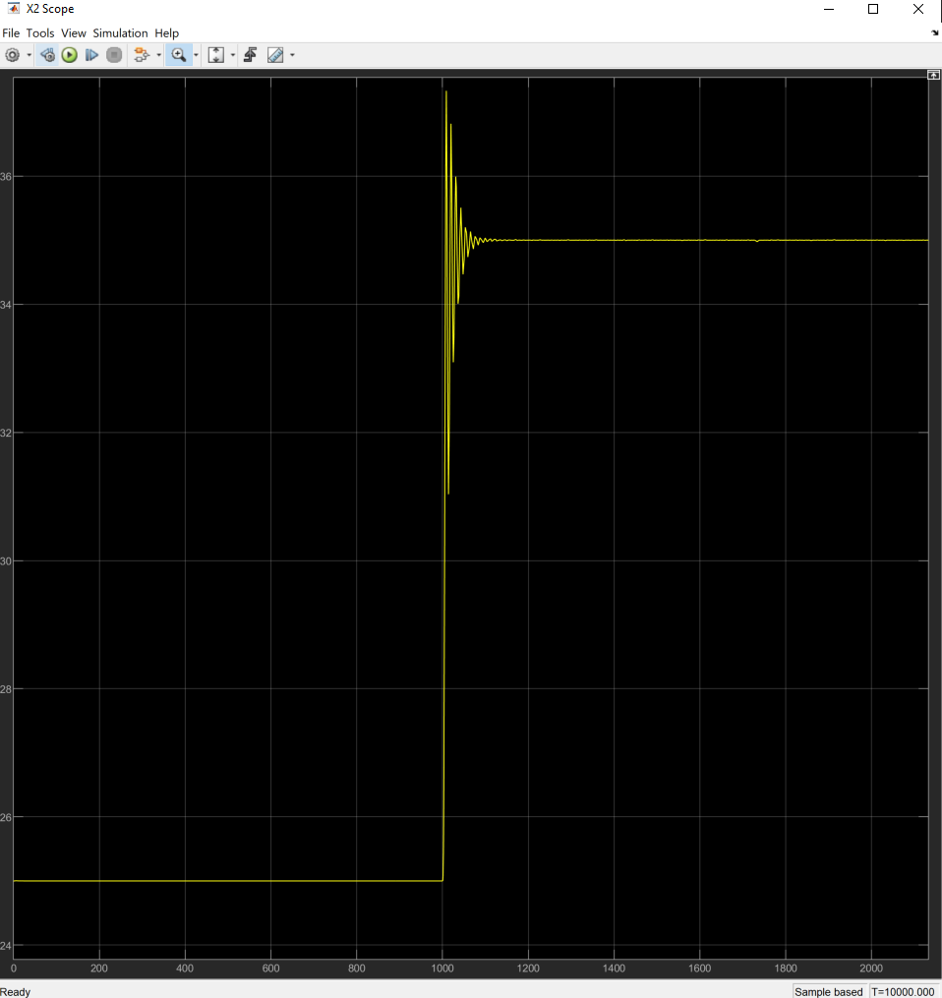
Response to step in
X2 Set Point: 25 -> 35
With no gain scheduling
i.e.
Kp constant at 5.2

Slide 6
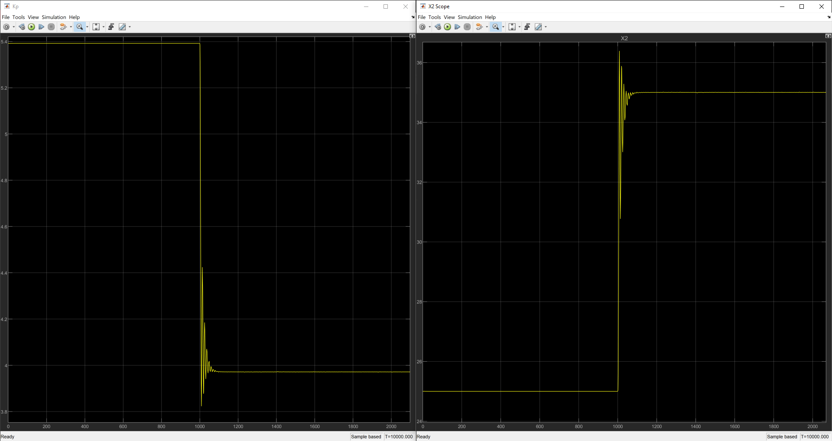
Step in X2 Set Point: 25 -> 35 with gain-scheduling, Kp transitions from 5.4 to 3.8

Slide 7
Still To Do:
- Try alternative implementation of scheduling in MATLAB (~ 15 mins)
Investigate integrator variable (~ 2 hours)
Robustness checks (~ 2 hours)
Need to agree on what tests to compare

Slide 8
